Slide 1
A06 TensorFlow Playground Presentation
Jesus Chavez

Slide 2
brief introduction to neural networks and their components:
Computational models modeled after neural networks are derived from the human brain. They are made up of nested, networked nodes arranged into three layers: output, hidden, and input. Every neuron receives input data, processes it, adds a bias, applies weights, and then runs the outcome through an activation function.
Basic units called neurons are able to process, receive, and produce inputs as well as outputs. The input layer is where the original data is received; the output layer is where the final output is produced; and hidden layers are intermediate layers that process inputs from the input layer. ReLU, sigmoid, and tanh are examples of activation functions that add non-linearity to a model. In order for the network to produce accurate predictions during training, it must learn parameters like weights and biases. For applications like speech and picture recognition, natural language processing, and more, neural networks are extremely useful tools. They are able to decipher intricate patterns and forecast outcomes using data.

Slide 3
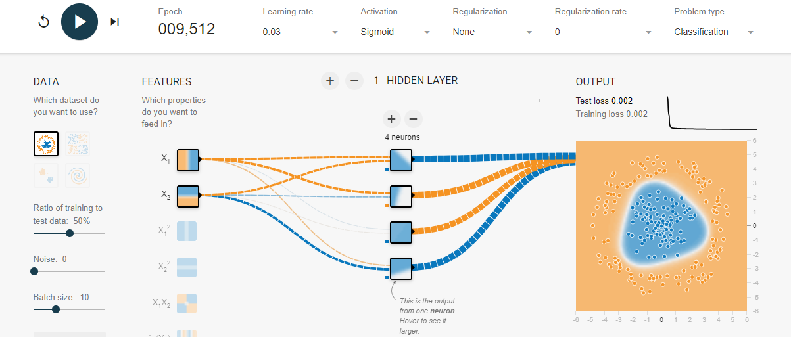
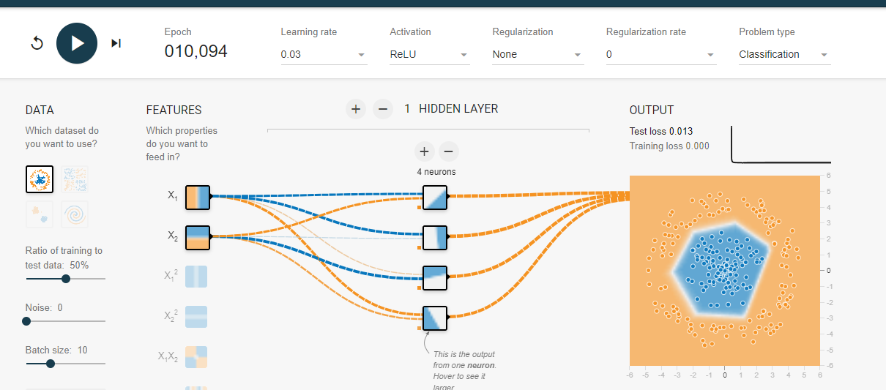
Task 1 - Activation Functions: Created a single hidden layer neural network and conducted experiments with sigmoid and ReLU activation functions.
ReLU has improved performance in deeper networks, sparser activations, and faster training.
Sigmoid training is slower, more successful in binary classification, and may have vanishing gradient problems.

Slide 4
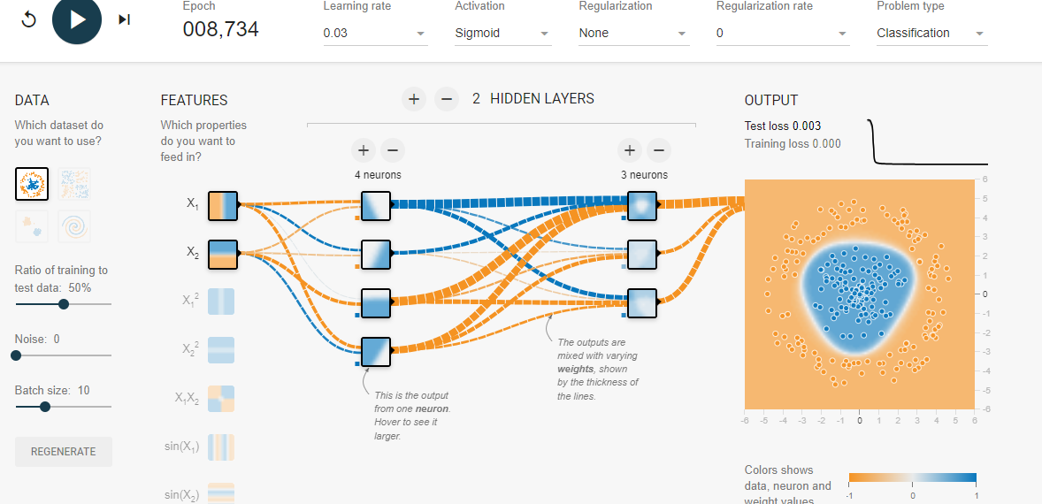
Task 2 - Hidden Layer Neurons:
Changed the number of neurons and hidden layers. While adding neurons and layers lengthened training time and raised the possibility of overfitting, overall performance was enhanced

Slide 5
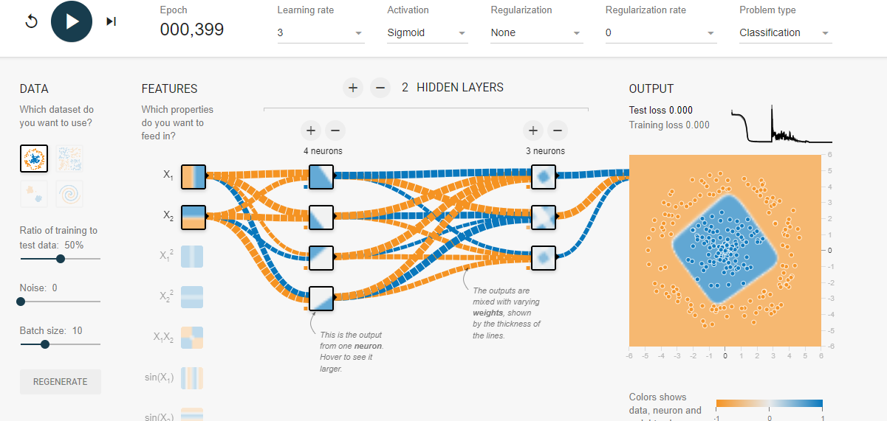
Task 3 - Learning Rate:
Modified the pace of learning to 3. While adding neurons and layers lengthened training time and raised the possibility of overfitting, overall performance was enhanced. Accelerating training with higher learning rates increased the risk of exceeding optimal values. Slower rates were slower but more accurate.

Slide 6
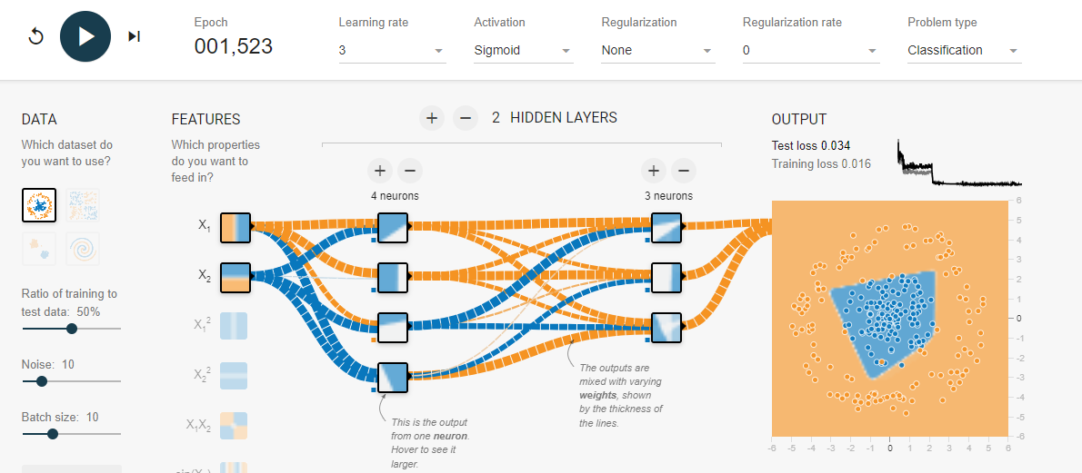
Task 4 - Data Noise:
noise was added to the data. The network's capacity to generalize was hampered by noise, emphasizing the significance of clean data.

Slide 7
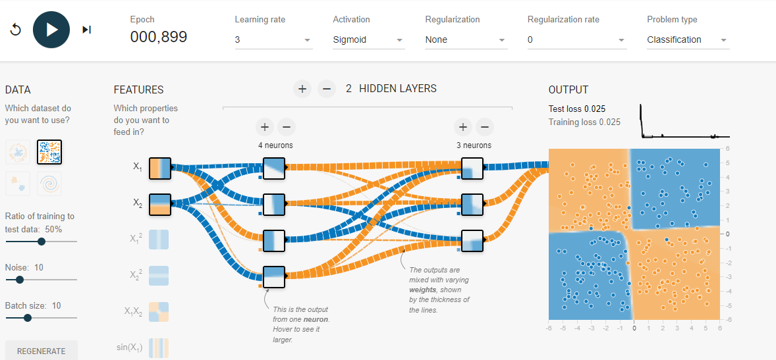
Task 5 - Dataset Exploration:
Investigated several datasets and found that performance differed between them, highlighting the significance of choosing the right dataset.

Slide 8
Detailed observations and explanations
ReLU's efficiency and capacity to reduce vanishing gradients make it the preferred choice for deep networks. While sigmoid is helpful for binary classification, training may be slowed down. Performance can be enhanced by adding more neurons and layers, but doing so also raises the complexity and overfitting risk. Effective training requires a balanced learning rate. Too high or too low can hinder learning and create instability. Reliable data is necessary for accurate generalization. Although it can aid in simulating real-world situations, noise should be carefully controlled. Various datasets can highlight the network's advantages and disadvantages. Selecting the right datasets is essential for efficient training.

Slide 9
practical implications
Comprehending these parameters facilitates the creation of neural networks that are effective and efficient for particular tasks. For example, selecting the appropriate learning rate and activation function can have a big impact on the training process and the outcome.

Slide 10
Conclusion
This practical use of TensorFlow Playground yielded insightful knowledge about neural network behavior. I gained knowledge about how various parameters impact performance and how crucial precise tuning is. Overfitting management and appropriate learning rate selection were challenges that were overcome by experimentation and observation.

Slide 11
References
Zhou, V. (2019, March 3). Machine Learning for Beginners: An Introduction to Neural Networks. victorzhou.com. https://victorzhou.com/blog/introto-neural-networks/
Ibm. (2024, October 2). Neural network. What is a neural network?
https://www.ibm.com/topics/neural-networks
GeeksforGeeks. (2024, January 3). What is a neural network?
GeeksforGeeks. https://www.geeksforgeeks.org/neural-networks-a-beginners-guide/

